Slide 1

JAVA PROGRAMMING
UNIT - V

Slide 2
Syllabus
Packages and Interfaces: Packages, Access Protection, Importing Packages, Interfaces.
Exception
Fundamentals,
Handling: Exception-Handling Exception Types, Uncaught
Exceptions, using Clauses, throw, Exceptions.
try and catch, throws, finally,
Multiple catch Java’s Built-in

Slide 3
Packages
Packages are containers for classes, interfaces and sub packages.
Ie. Is used to group related classes and interfaces.
Packages are used for avoiding name conflicts, to control access, to make searching/locating and usage of classes, interfaces, and annotations easier, etc.
In any java file the first statement should be a package statement.

Slide 4
Advantages of Java Package:
Java package is used to categorize the classes and interfaces so that they can be easily maintained.
Java package provides access protection.
Java package removes naming collision

Slide 5
Some of the existing packages in Java are :
Java provides a large number of classes grouped into different packages based on their functionality.
The six foundation Java packages are:
- java.lang :
Contains classes for primitive types, strings, math functions, threads, and exception.
- java.util :
Contains classes such as vectors, hash tables, date etc.
- java.io :
Stream classes for I/O .
- java.awt :
Classes for implementing GUI – windows, buttons, menus etc.
- java.net :
Classes for networking .
- java.applet :
Classes for creating and implementing app.

Slide 6
Defining a Package
To create a package: include a package command as the first statement in a Java source file.
package NameOfPackage;
Example - creates a package called MyPack.
package MyPack;
Java uses file system directories to store packages. For example, the package MyPack must be stored in a directory called MyPack. the directory name must match the package name exactly.

Slide 7
Example
//save by A.java package MyPack; public class A {
int a;
public void display(int x) { a=x;
System.out.println("MyPack a = "+ a);
}
}

Slide 8
How to access package from another package?
There are three ways to access the package from outside the package.
import packageName.*;
import packageName.ClassName;
fully qualified name.

Slide 9
1) Using packagename.*
use import PackageName.*;
Hence all the classes and interfaces of this package will be accessible but not sub packages.

Slide 10
Example
import MyPack.*; class B{
public static void main(String args[]){ A Obj = new A();
Obj.dispa(5);
}
}

Slide 11
2) PackageName.ClassName : only named class of this package will be accessible.
import MyPack.A; class B{
public static void main(String args[]){ A Obj = new A();
Obj.dispa(5);
}
}

Slide 12
3) Using fully qualified name
There is no need to import.
But need to use fully qualified name every time when you are accessing the class or interface.
It is generally used when two packages have same class name

Slide 13
Example
class B {
public static void main(String args[]){
MyPack.A Obj = new MyPack.A(); Obj.dispa();
}
}

Slide 14
Access Protection
Java addresses four categories of visibility for class members:
🞑 Subclasses in the same package
🞑 Non-subclasses in the same package
🞑 Subclasses in different packages
🞑 Classes that are neither in the same package nor subclasses
The three access modifiers, private, public, and protected.

Slide 15
Access Protection
Anything declared public can be accessed from anywhere.
Anything declared private cannot be seen outside of its class.
When a member does not have an explicit access specification, it is visible to subclasses as well as to other classes in the same package. This is the default access.
If you want to allow an element to be seen outside your current package, but only to classes that subclass your class directly, then declare that element protected.

Slide 16
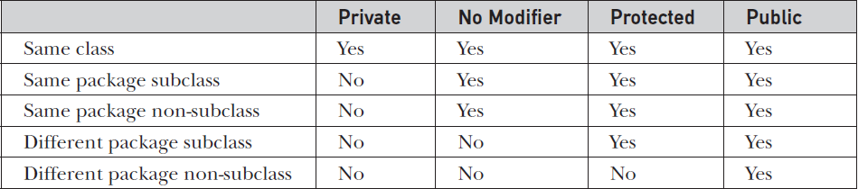
Access Protection
The public members can be accessed everywhere.
The private members can be accessed only inside the same class.
The protected members are accessible to every child class (same package or other packages).
The default members are accessible within the same package but not outside the package.

Slide 17
concrete method and concrete classes
Concrete Method: Any method which has both the declaration and definition(Implementation) is called as concrete method.
Void display()
{
System.out.println(“concrete Method”);
}
Concrete class: Any class which has only concrete methods is called as concrete class.
Class concrete
{
void display()
{
System.out.println(“concrete class”);
}
}

Slide 18
Abstract method and abstract class
Abstract method: Any method which is declared with the keyword abstract(without implementation) is called as abstract method.
Example: abstract void display();
Abstract class: Any class which is declared with the keyword abstract is called abstract class.
Abstract class can contain abstract method and non abstract method(concrete method) also.
Example:
abstract class tester
{
void display()
{
System.out.println(“concrete class”);
}
abstract void test();
}

Slide 19
Note on abstract class:
We cannot create object for abstract class and interface.
We cannot declare abstract method as static, final and private.
Abstract class will have constructor.
A class which provides implementation for abstract method is called as implementation class.
All the abstract methods should be overridden in the subclass else the subclass should be declared as abstract.
A class have an abstract method then compulsorily the class should be declared as abstract.

Slide 20
Interfaces
Another way to achieve abstraction in Java, is with interfaces.
An interface is a completely "abstract class" that is used to group related methods with empty bodies:
interface Animal {
public void animalSound(); public void run();
}
Using the keyword interface, you can fully abstract a class’ interface from its implementation.

Slide 21
Defining an Interface
The general form of an interface is:
interface InterfaceName {
return-type method-name1(parameter-list);
return-type method-name2(parameter-list); type final-varname1 = value;
type final-varname2 = value;
//...
}

Slide 22
Interface…
Using interface, you can specify what a class must do, but not how it does it.
Interfaces are syntactically similar to classes
All the variables present in the interface are by default “public static and final”.
Methods in interfaces are declared without any body.
“implements” keyword is used for implementing interfaces to the class.
Interfaces are designed to support dynamic method resolution at run time.
Through interface we can achieve 100% abstraction.

Slide 23
Interface…
Interface does not have constructor.
Interfaces does not extends any class, interface itself is the super most.
To inherit the properties from interface to interface we use extends.
All the abstract methods in the interface should be overridden in the subclass hence the subclass should be declared as abstract.
We can create a reference variable for interface but not an object.

Slide 24
Example
interface A{
void method1();
}
class B implements A{
public void method1(){ System.out.println("Method 1");
}
}
class MyClass{
public static void main(String[] args) { B obj = new B();
obj.method1();
}
}

Slide 25
Extending Interfaces
One interface can inherit another by use of keyword extends.
When a class implements an interface that inherit another interface.

Slide 26
Example
interface A{
void method1(); void method2();
}
interface B extends A{
void method3();
}
// B now includes method1 and method2
//the class must implement all method of A and B.
class C implements B{
public void method1(){
System.out.println("Method 1");
public void method2(){
System.out.println("Method 2");
public void method3(){
System.out.println("Method 3");
}
}
}
}

Slide 27
Example
class MyClass {
public static void main(String args[]){ C obj = new C();
obj.method1(); obj.method2(); obj.method3();
}
}

Slide 28
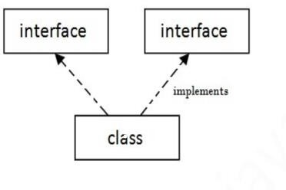
Multiple inheritance in Java by interface
If a class implements multiple interfaces, it is known as multiple inheritance.

Slide 29
Multiple inheritance in Java by interface - Example
interface A{
void method1(); }
interface B{
void method2(); } class C implements A, B{
public void method1(){
}
public void method2(){
}
System.out.println("Method 1");
System.out.println("Method 2");
}
class MyClass {
public static void main(String args[]){ C obj = new C();
obj.method1();
obj.method2();
}
}

Slide 30
Default Method in Interface
- Can have method body in interface.
- But need to make it, default method.
interface A{
void method1();
default void method2(){
}
System.out.println("Method 2");
}
class C implements A{
public void method1(){
}
}
class MyClass {
System.out.println("Method 1");
public static void main(String args[]){
A obj = new C(); obj.method1(); obj.method2();
}
}

Slide 31
Static Method in Interface - we can have static method in interface.
interface A{
void method1();
static void method2(){
}
System.out.println("Method 2");
}
class C implements A{
public void method1(){
}
}
class MyClass {
System.out.println("Method 1");
public static void main(String args[]){
A obj = new C(); obj.method1(); A.method2();
}
}

Slide 32
Differences Between – Class and Interface
Class | Interface
The keyword used to create a class is “class” | The keyword used to create an interface is “interface”
A class can be instantiated i.e, objects of a class can be created. | An Interface cannot be instantiated i.e, objects cannot be created.
Classes does not support multiple inheritance. | Interface supports multiple inheritance.
It can be inherit another class. | It cannot inherit a class.
It can be inherited by another class using the keyword ‘extends’. | It can be inherited by a class by using the keyword ‘implements’ and it can be inherited by an interface using the keyword ‘extends’.
It can contain constructors. | It cannot contain constructors.
It cannot contain abstract methods. | It contains abstract methods only.
Variables and methods in a class can be declared using any access specifier(public, private, default, protected) | All variables and methods in a interface are declared as public.
Variables in a class can be static, final or neither. | All variables are static and final.

